Slide 1
Infectious Diseases
Prof Keith Neal

Slide 2
Mortality
One in eight of all deaths
Mainly respiratory
Pneumonia, influenza
Cancers
Stomach, head and neck, cervix, liver, oesophageal
Digestive disease
Ulcers, liver

Slide 3
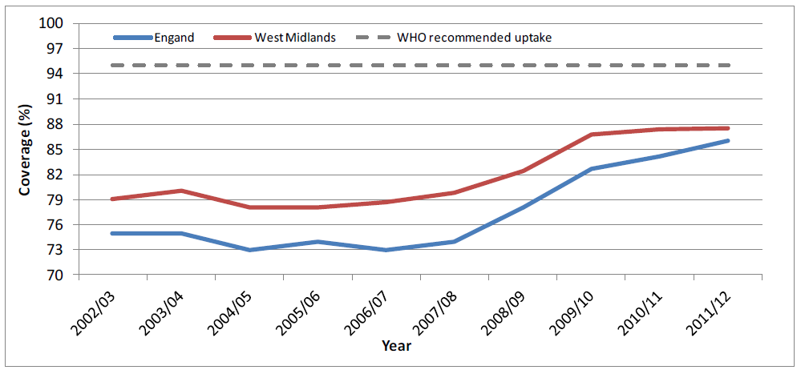
Measles
Confirmed measles cases in West Midlands
Uptake of MMR1 and MMR2

Slide 4
Pertussis
Confirmed pertussis cases in the West Midlands
Rate per 100,000 confirmed Pertussis cases; 2012 Jan to Oct

Slide 5
TB
TB rates per 100,000 by PCT
TB in West Midlands – 2002 - 2011

Slide 6
Selected TB clusters in West Midlands

Slide 7
HIV

Slide 8
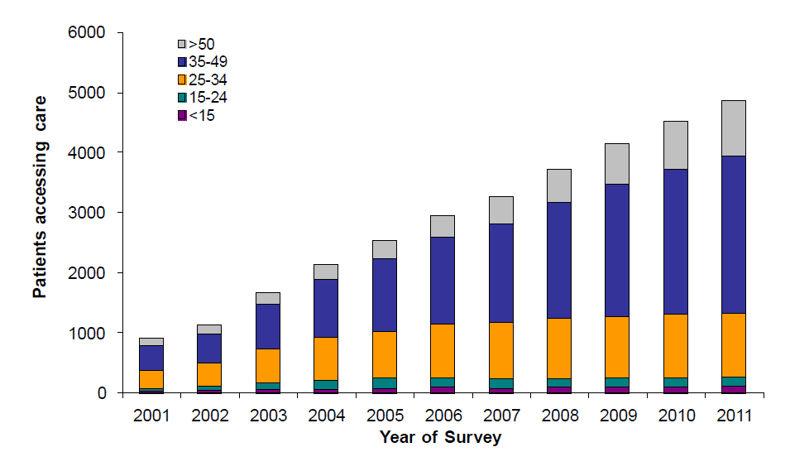
West Midlands residents receiving care for HIV by age group

Slide 9
STIs

Slide 10
STIs – Chlamydia diagnoses in West Midlands GUM clinics: 1996 to 2010
Males
Females

Slide 11
Hepatitis C

Slide 12
Summary
Measles is preventable
Pertussis – pregnant women vaccine programme
TB – typing systems helping control strategies
HIV – new cases occurring in high risk groups
STIs – totally resistant gonorrhoea and HPV vaccine will have major benefits
Hepatitis C – described as a ticking time bomb

